Slide 1

MoonGlim Jewelry
Mouyseang, Audrey, Roshan

Slide 2


Company Overview
Direct to customer (D2C) company
Sell pre-designed pieces with highest-quality gemstones, precious metals, and pearls
Online store since 2000
Available across nation

Slide 3
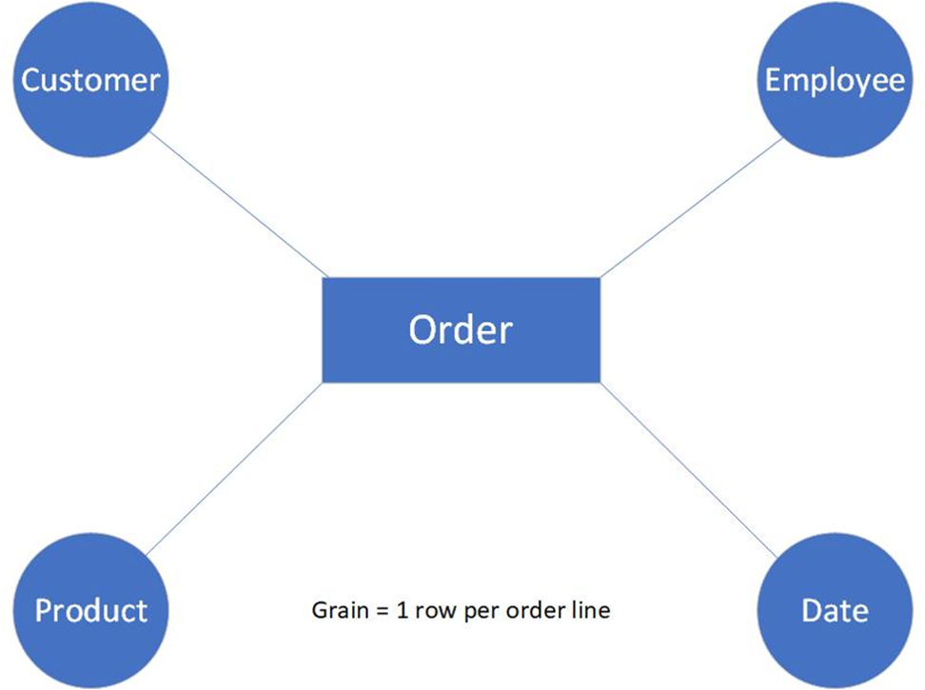
Entity Relationship Diagram

Slide 4
Business Requirement Questions
The CFO would like to know the total revenue by year and quarter.
The product manager wants to know which products are the most and least popular among customers.
The product manager wants to know which product type generates the most revenue.
The CCO wants to know which products are most popular in each state.
The CCO wants to know which products are most popular in each state.
The CFO wants to know which states generate the most revenue, broken down by product type.

Slide 5
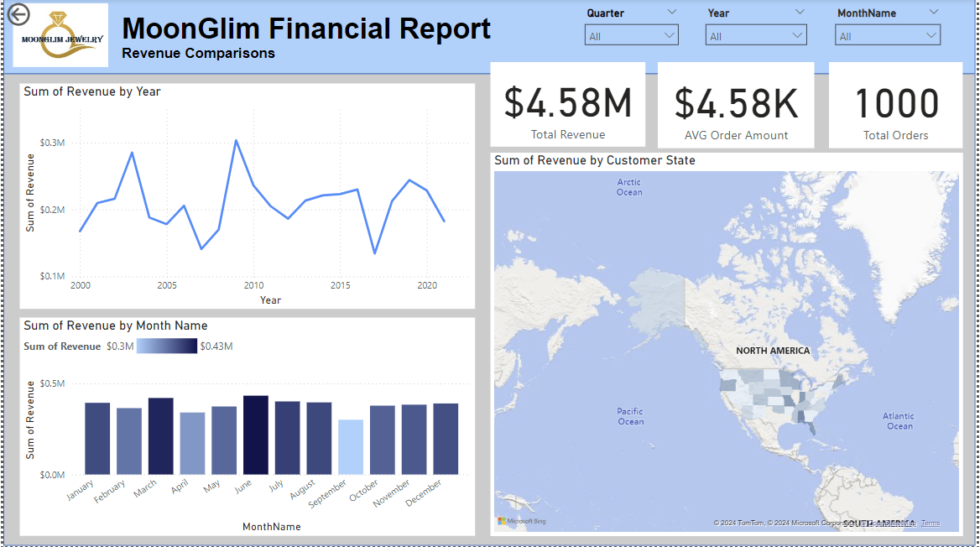
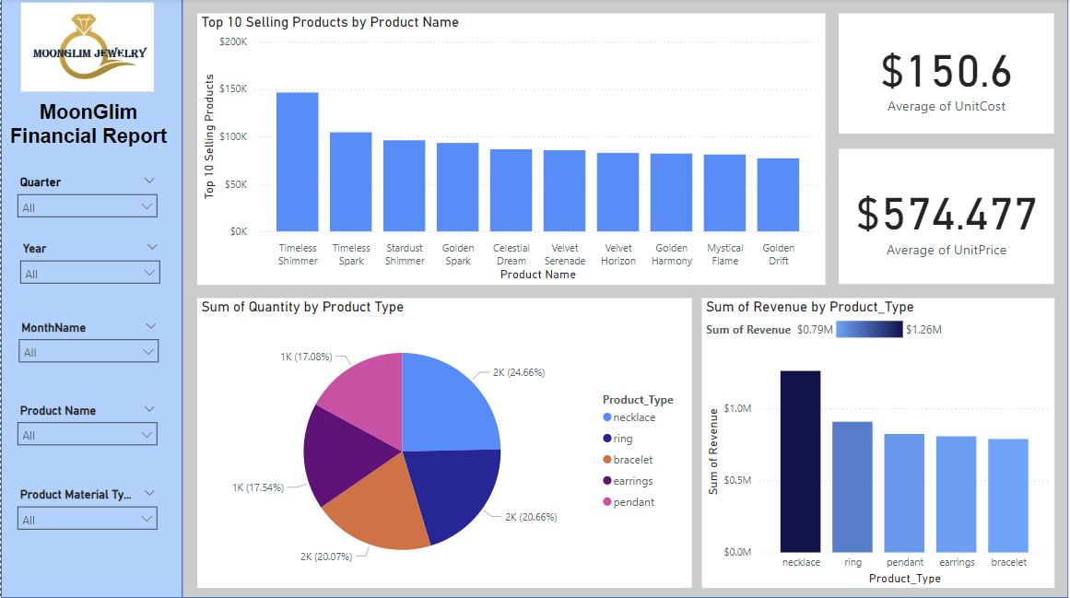
2 Part Dashboard Analysis

Slide 6
Insights and Recommendations
Leverage Monthly Trends:
Sales Complain to increase September revenue
Address Revenue Fluctuations Over Time
Assign data team to investigate the reasons for such extreme fluctuation
Look into why bracelets are not selling well
Remarket bracelets and push to get them selling
Notes:
Leverage Monthly Trends:
The bar chart displaying monthly revenue shows noticeable variations. For months with lower revenue, consider implementing specific marketing campaigns, discounts, or seasonal product launches to boost sales.

Slide 7

Challenges
Difficulty populating the fact table from ETL
Most of the source data needed to be made from scratch
Mistakes with writing the fact table script led to hours of bug fixing

